Slide 1


MASTER DECK -

Slide 2

How to Use Drug R&D Ecosystem
Xinghua Liang
Base Solution Core Author
Blockchain Developer

Slide 3

Summary
Two Roles
Task Owner:
Create a task, provide a drug structure, initiate loyalty token
AI Player
Accept a task, take drug structure as input, do AI computation, and share result with task owner
Three Scenarios
Scenario 1:
101 Handshake
Scenario 2:
Choose the Best
Scenario 3:
Compete for Success
Four Components
Legitimation
Loyalty Token Management
Task Management
Drug Ecosystem (S3 Only)

Slide 4
Scenario 1: 101 Handshake
Description:
One drug lunch team initiates a drug task (requires only one AI team to compute drug efficacy) and add to the ecosystem. An AI team picks the task, compute drug efficacy, and return the result. Then the drug team confirms the result. Finally, the drug R&D ecosystem award the AI team with loyalty tokens.

Slide 5
Scenario 2:Choose the Best
Description:
One drug lunch team initiates a drug task (requires three AI team to compute drug efficacy) and add to the ecosystem. Three AI teams pick the task, compute drug efficacy, and return their results. Then the drug team confirms the results. Finally, the drug R&D ecosystem do cross validation, and award the AI team having best result with loyalty tokens.

Slide 6
Scenario 3: Compete for Success
Description:
Many (at least three) drug lunch teams initiates many (at least five) drug tasks in total. These five tasks are added to a pool. Three AI teams pick tasks from the pool individually. Then for each finished task, the drug R&D ecosystem do cross validation, and award the best AI team with loyalty tokens.

Slide 7
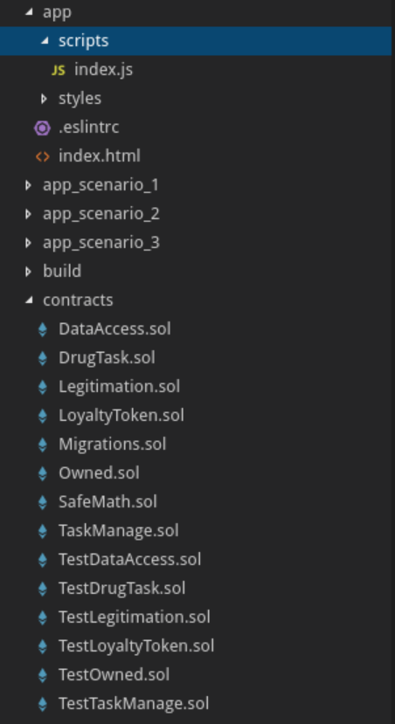
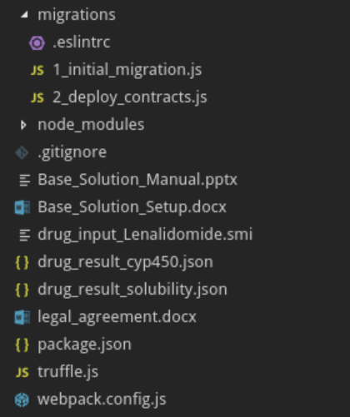
Code Structure
Front end:
JS functions
Page layout
Deploy scripts: Used by Truffle
Modules used in webpack
Copies of
“app”, “contracts”, “migrations” for corresponding scenarios
Documents for base solution
Files for testing base solution
Smart contracts:
Functional contracts
Unit test contracts
Config files for Truffle and webpack
Code Structure for Base Solution
See next slide for more details

Slide 8
Code Structure
Smart Contracts
See “contracts” folder
Functional contracts for four components in P3
Unit test contracts for corresponding contracts (started with “Test”)
Front End
See “app” folder
index.html is for page layout
scripts/index.js has all front end JS functions
Deploy Scripts
See “migrations” folder
Used by Truffle
Decide which contracts you want to deploy to Ethereum network in “2_deploy_contracts.js”
Documents
Check Base_Solution_Setup.docx to know how to setup the environment for code development
Check Base_Solution_Manual.pptx to know how to use the base solution for Drug R&D Ecosystem
Files for Base Solution
legal_agreement.docx: template for legitimation
drug_input_Lenalidomide.smi*: drug input file
drug_result_cyp450.json*: drug result file, with value 0.0
drug_result_solubility.json*: another drug result file, with value -2.660000086
* Drug input and result files are kindly provided by XtalPi

Slide 9
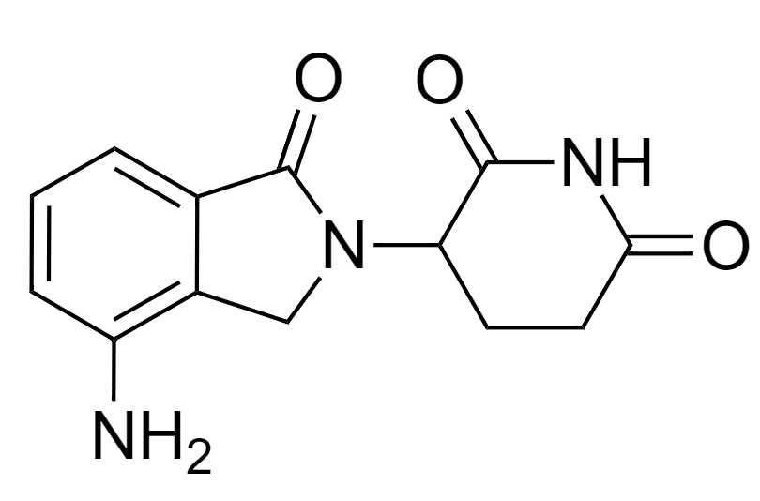
Drug Example Background
Lenalidomide: a derivative of thalidomide approved by FDA in 2005. It was initially intended as a treatment for multiple myeloma, for which thalidomide is an accepted therapeutic treatment. Along with several other drugs developed in recent years, lenalidomide has significantly improved overall survival in myeloma (which formerly carried a poor prognosis), although toxicity remains an issue for users.
CYP450: Cytochrome P450 are important enzymes in the body. They oxidizes small foreign organic molecules (toxins or drugs), so that they can be removed from the body. The result value indicates the possibility of a drug molecule being metabolized by CYP450 enzymes, wherein reasonable range is [0, 1].
Solubility: logarithmic value of molecule solubility. Insoluble < -10 < poorly < -8 < moderately < -6 < soluble < -4 < very soluble < -2 < highly soluble. Training set range is [-9, 2], wherein [-5, 2] is proper range for drug discovery.
* Background of drug example is kindly provided by XtalPi

Slide 10
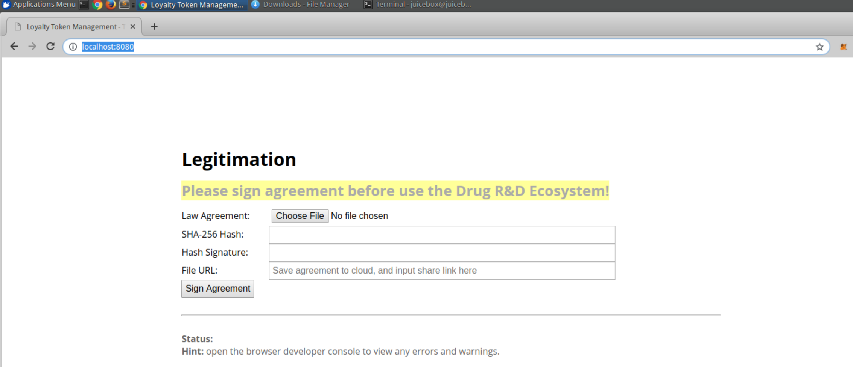
Run the Drug R&D Ecosystem
Follow the instruction of “Base_Solution_Setup.docx”
In Chrome, open URL http://localhost:8080, and you shall be able to see the webpage below

Slide 11
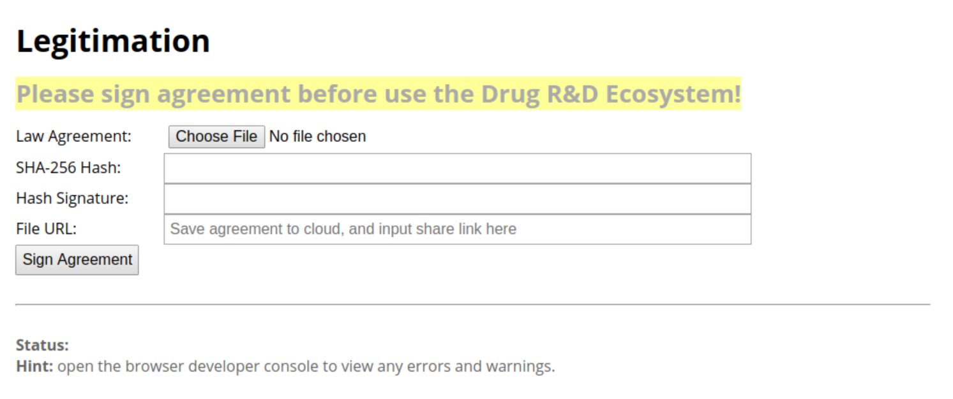
Legitimation
As the first step, every user (Task Owners and AI Players) needs to sign legal agreement before doing further operations

Slide 12
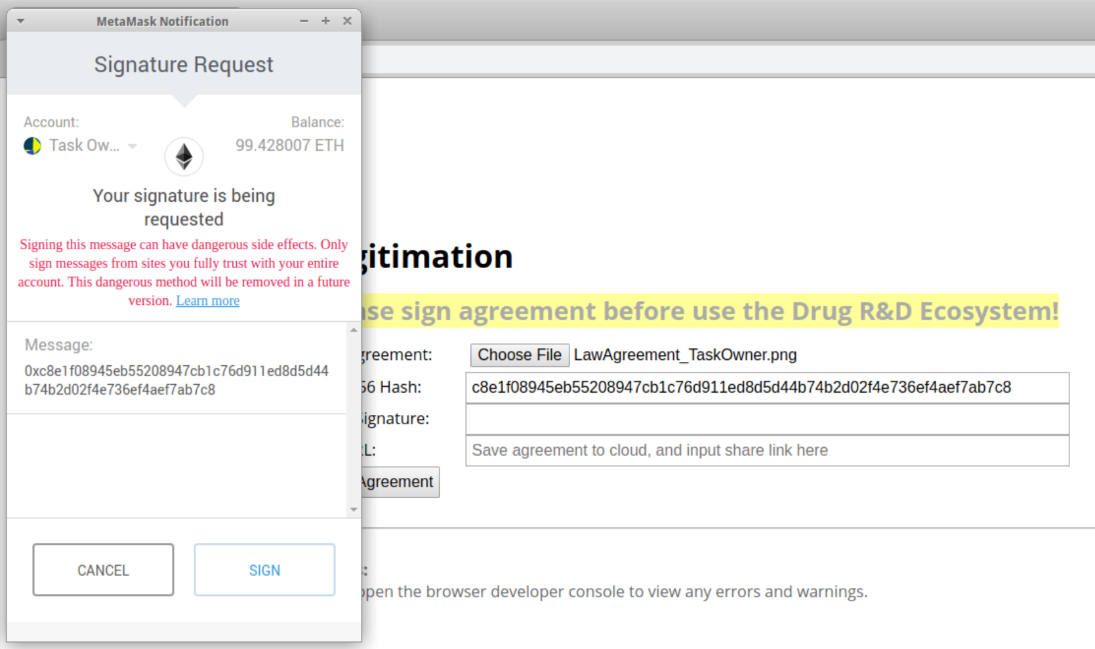
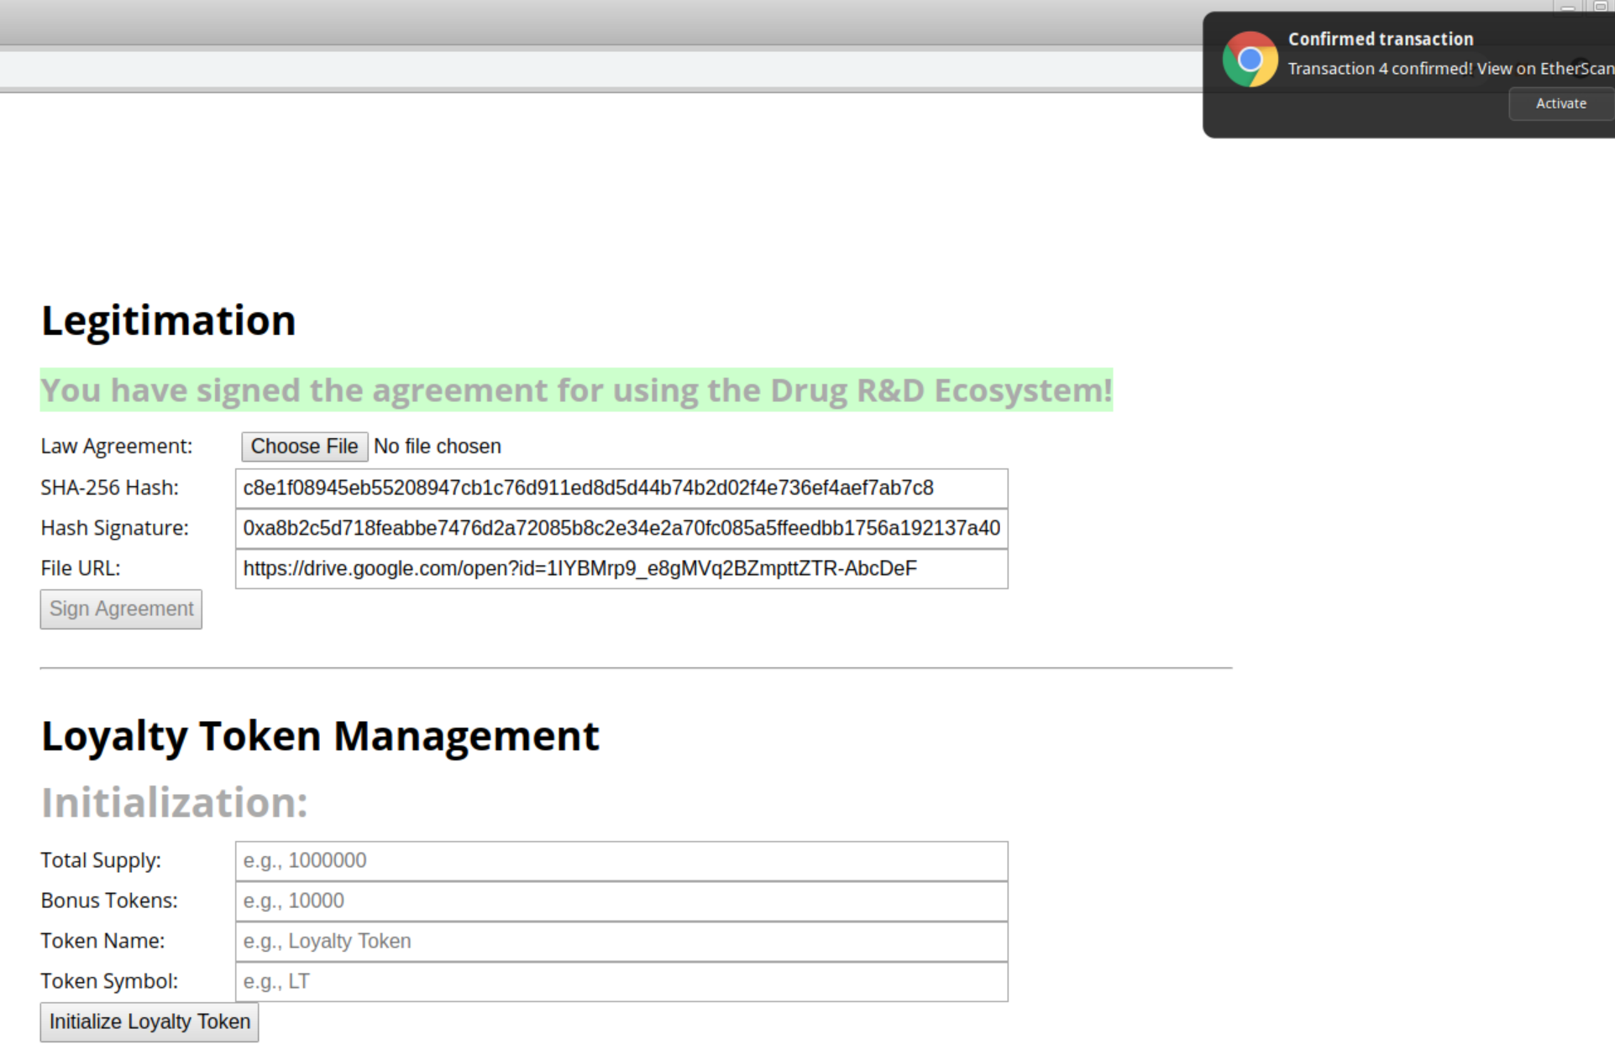
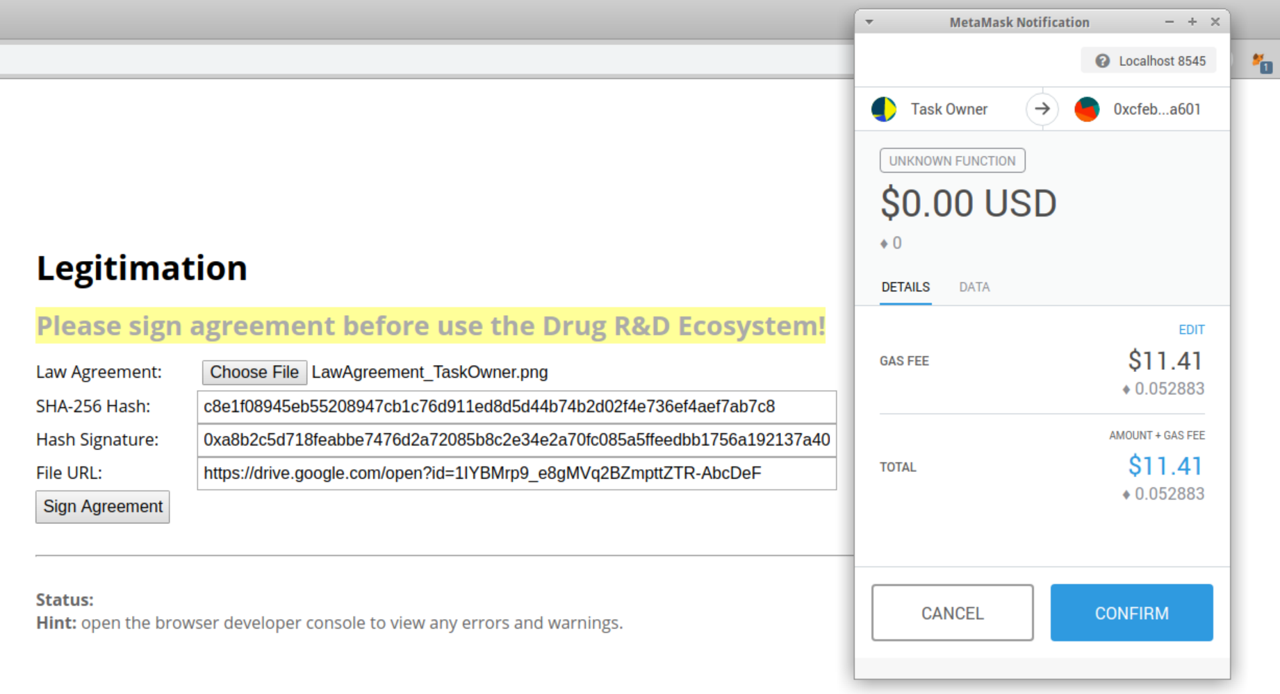
Legitimation
6. Wait until your transaction is confirmed in the Ethereum network, and then REFRESH page.
1.
7. Your signed agreement will auto retrieved from blockchain and show up here
2.
8. Panels for Loyalty Token Management and Task Management will display after signing the legal agreement
4.
3. Upload agreement to cloud, and paste the URL here
5.

Slide 13
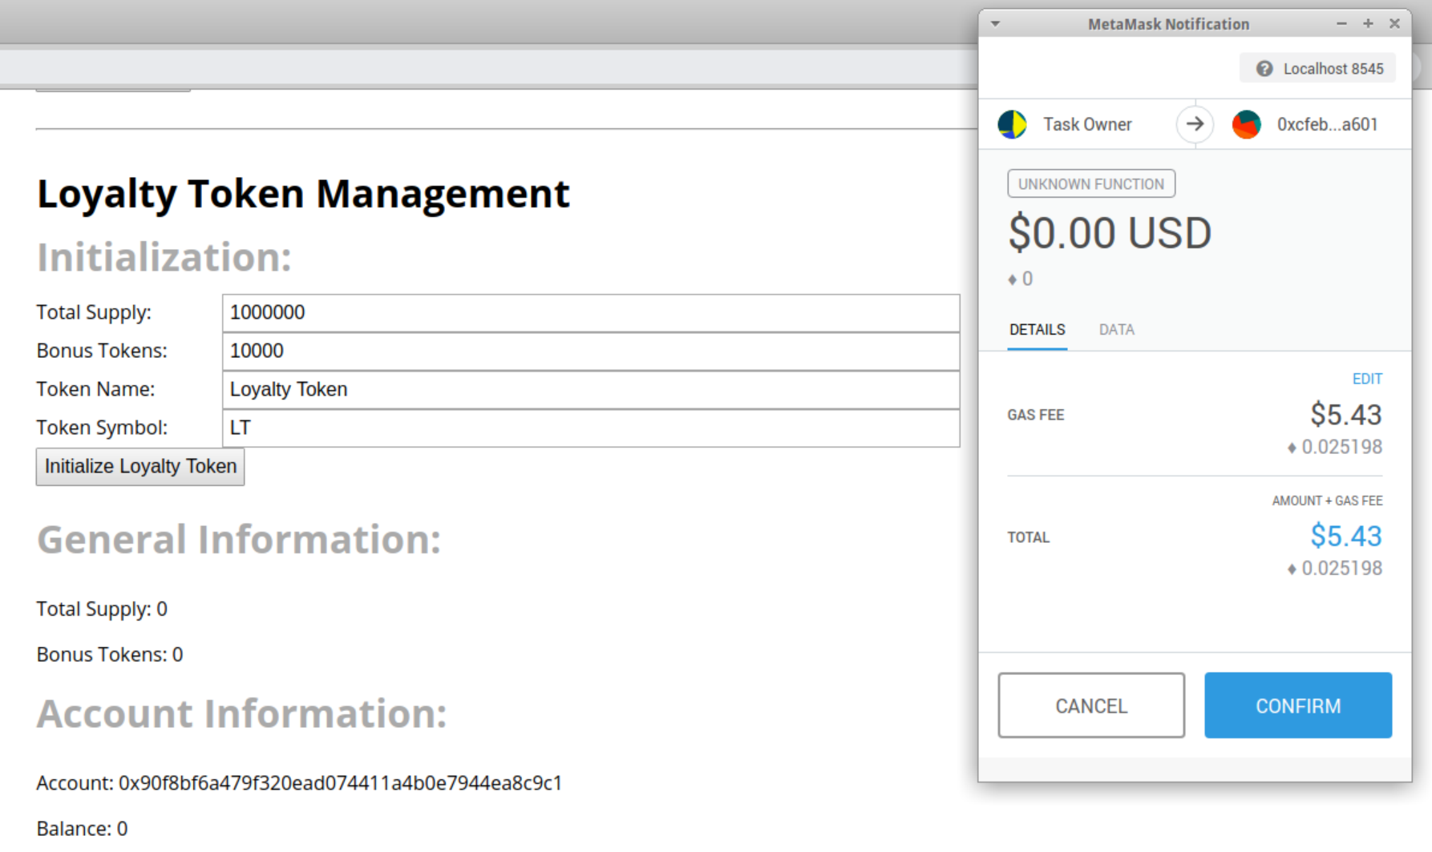
Loyalty Token Management
Only Task Owner can do initialization here
In the example, we will use default values to initialize
1. Initiate with default values
2.

Slide 14
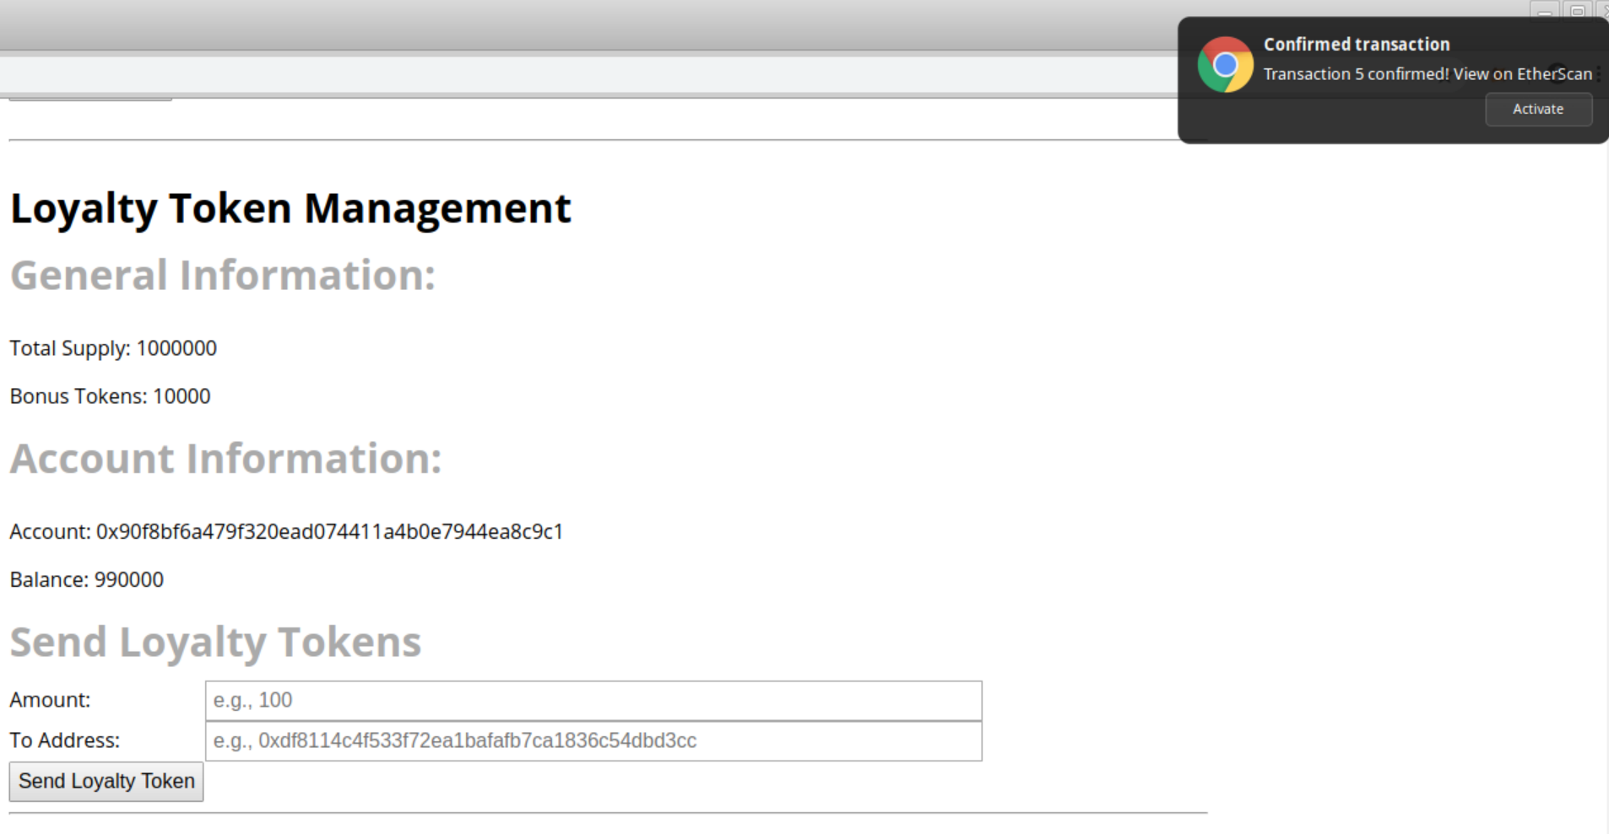
Loyalty Token Management
3. Wait until your transaction is confirmed in the Ethereum network, and then REFRESH page.
4. Check token information, as well as your account address and balance
Notice that 10,000 LT is reserved for bonus, and thus Task Owner only has 990,000 LT
5. You can also send a certain amount of LT to other users by their account address

Slide 15
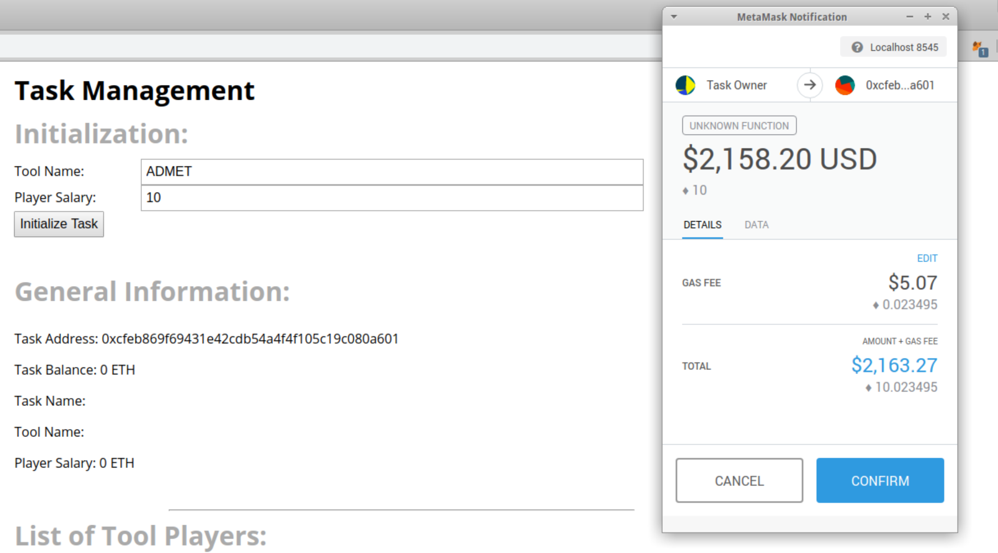
Task Management: Create A Task
Only Task Owner can initialize a task
In the example, we will use following values to initialize
1. Only Task Owner can see this section
2.

Slide 16
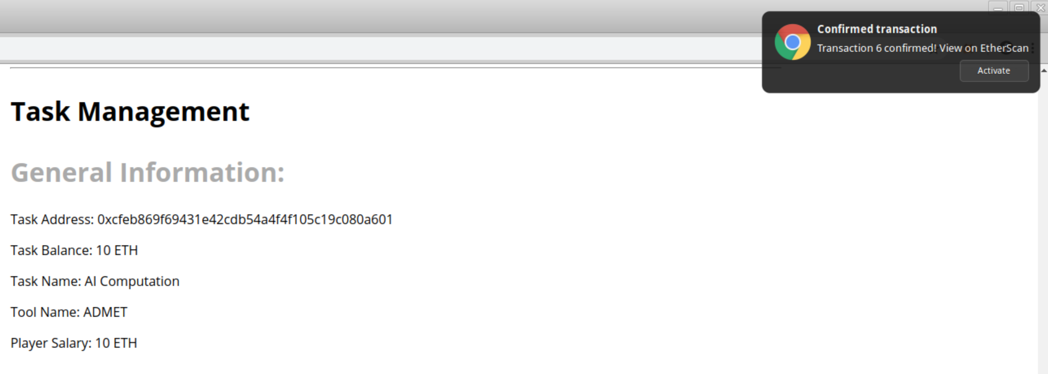
Task Management: Create A Task
3. Wait until your transaction is confirmed in the Ethereum network, and then REFRESH page.
4. Task is successfully created, and everyone can check task information here

Slide 17
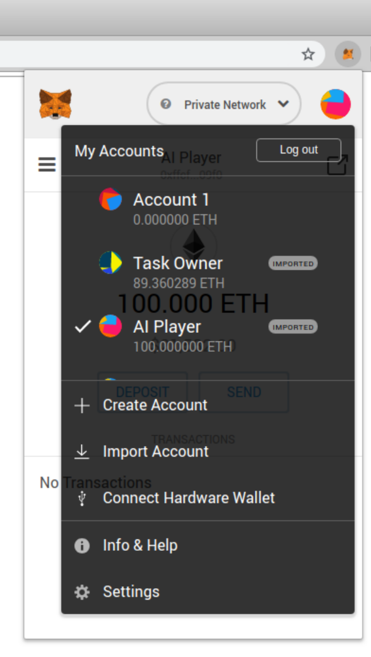
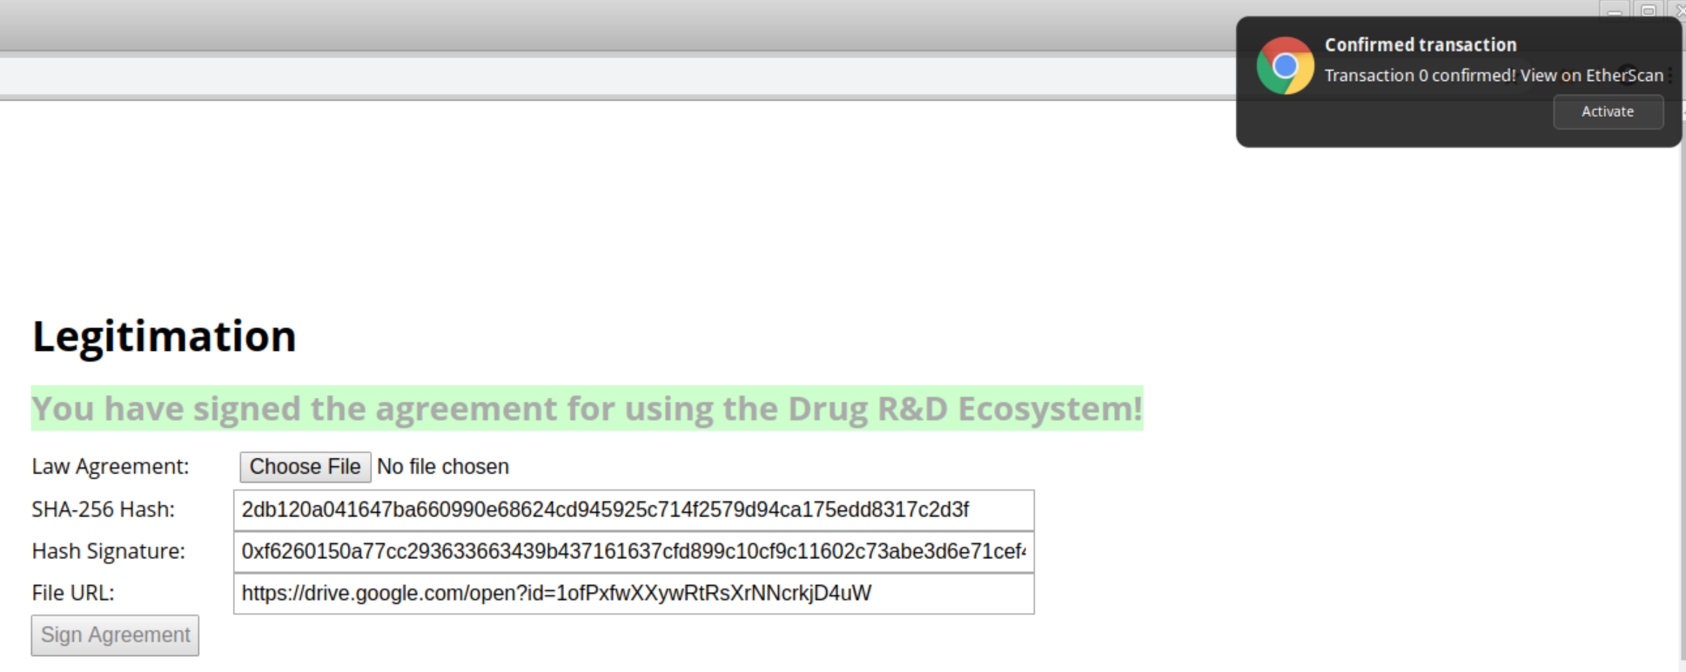
Task Management: Apply A Task
Only AI Players with addresses different from Task Owner can apply to accept a drug task. Therefore, we need to SWITCH Ethereum account to an AI Player account
Notice: AI Player needs to sign legal agreement before applying for a task.
1.
2. Choose AI Player
3. Sign legal agreement

Slide 18
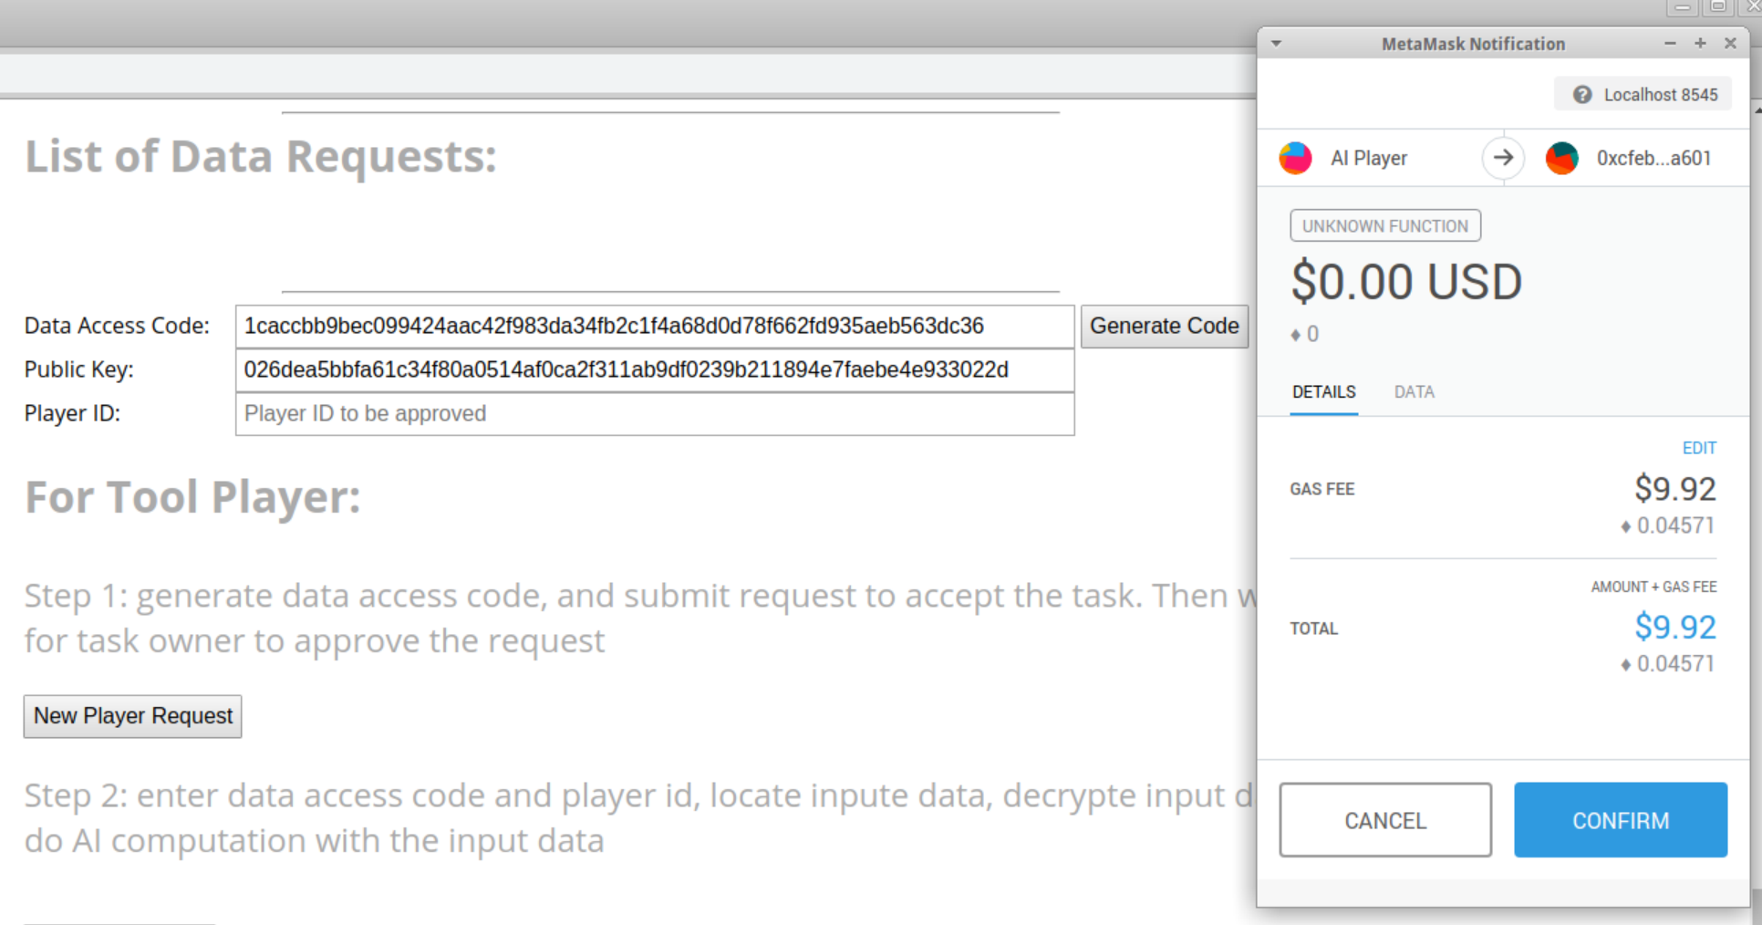
Task Management: Apply A Task
1. Click to generate a random Data Access Code (private key) for ECIES, save it to your computer. DON’T LOSE THE CODE!!! You will need it to decrypt input file and encrypt result in future.
2. Click to apply for the task
3.

Slide 19
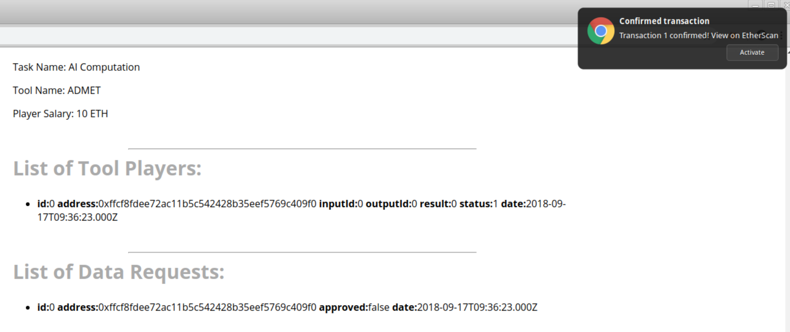
Task Management: Approve An AI Player
Please SWITCH to Task Owner for this operation
1. Wait until your transaction is confirmed in the Ethereum network, and then REFRESH page.
2. All AI Players applied for this task will be listed here, with their player ID, account address, status, date, etc.
3. A data request is used to securely transfer data between Task Owners and AI Players. Here ID 0 is for drug input data

Slide 20
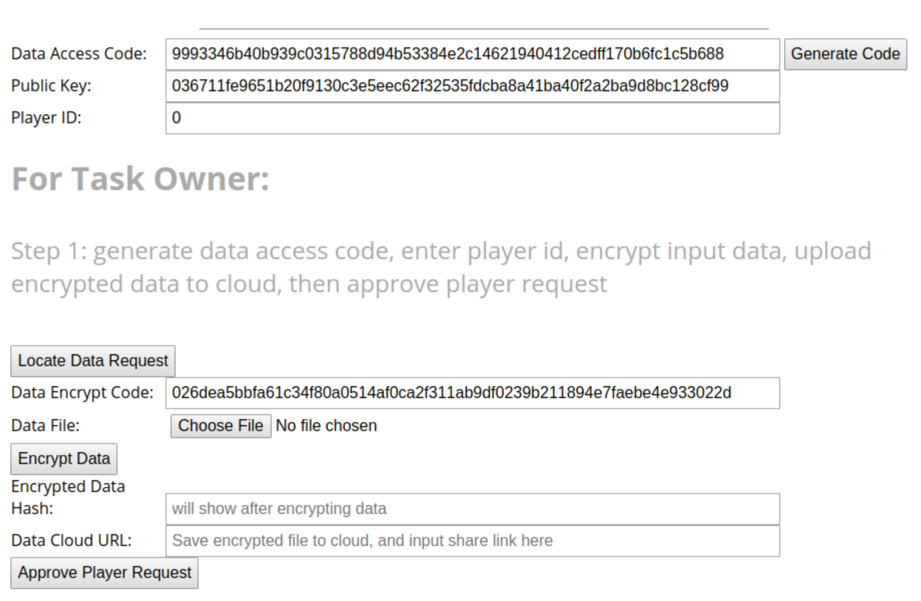
Task Management: Approve An AI Player
4. Click to generate a random Data Access Code (private key) for ECIES, save it to your computer. DON’T LOSE THE CODE!!! You will need it to decrypt input file and encrypt result in future.
5. Choose an AI Player by his player ID, here 0 because there is only 1 AI Player
6. Locate Data Encrypt Code (public key) from blockchain

Slide 21
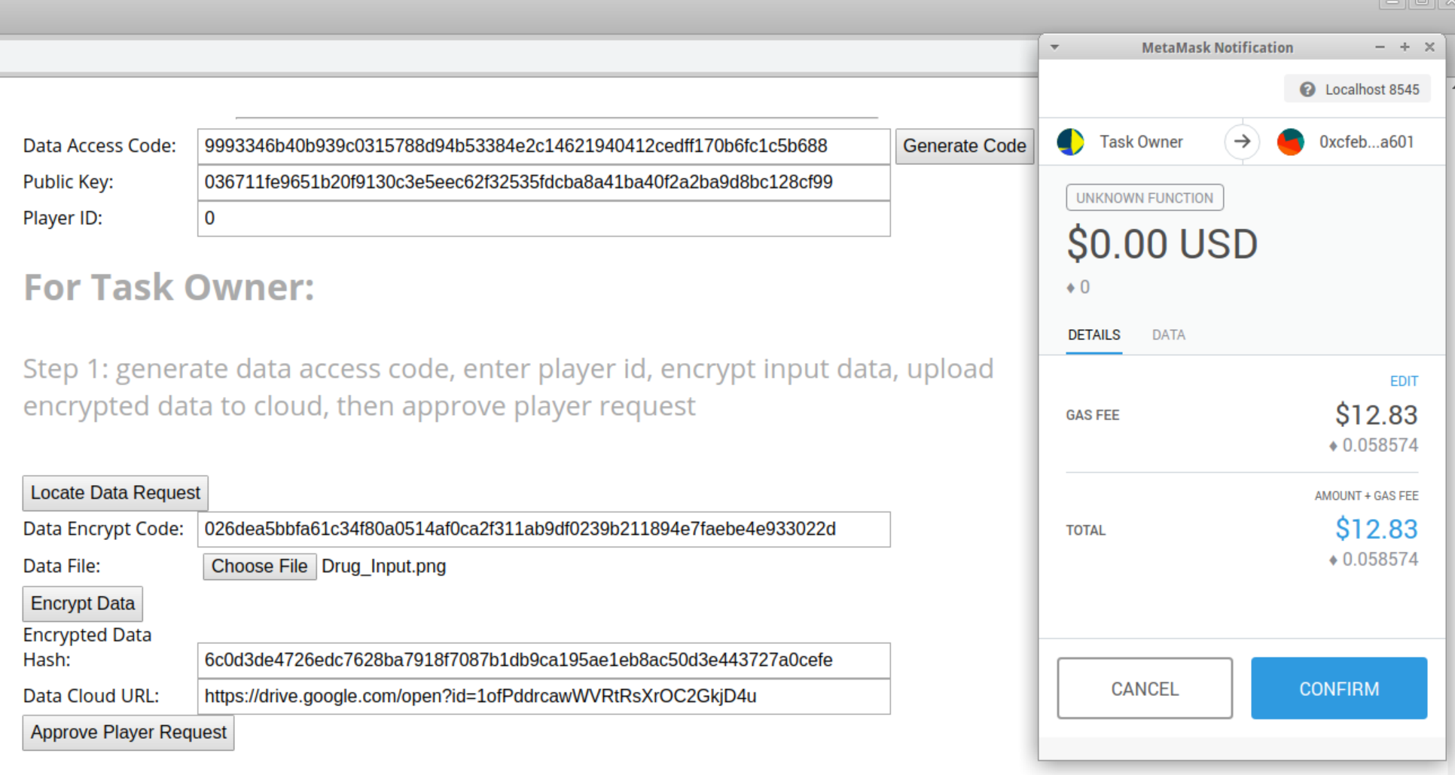
Task Management: Approve An AI Player
7. Choose the drug structure, click “Encrypt Data” and you will get a downloadable file encrypted with ECIES
9.
8. Upload the encrypted input file to cloud, put the URL here, and approve the AI Player with player ID “0”

Slide 22
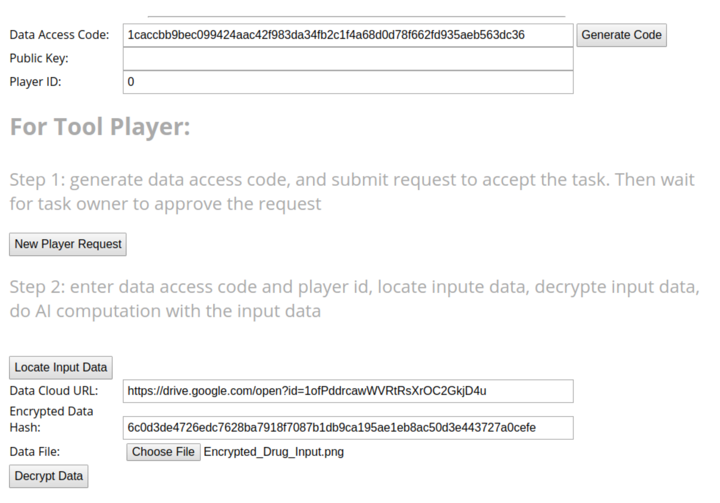
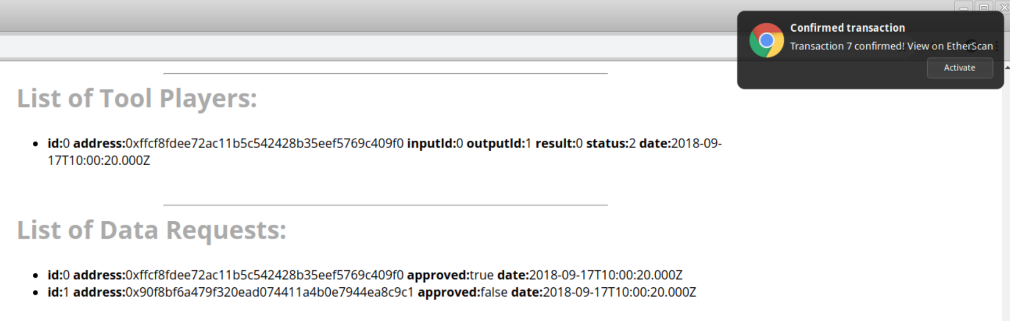
Task Management: Do AI Computation
3. Put the data access code generated in “Apply A Task” here
Please SWITCH to AI Player for this operation
Decrypt input data with Data Access Code
4. You AI Player ID
1. Wait until your transaction is confirmed in the Ethereum network, and then REFRESH page.
5. Click “Locate Input Data” to retrieve data URL and hash from blockchain, download the encrypted file
6. Choose the encrypted file, then click “Decrypt Data”. Data access code in step 3 above will be used to decrypt the data, and you will obtain the decrypted data input
2. New data request with ID 1 is going to be used for AI Results

Slide 23
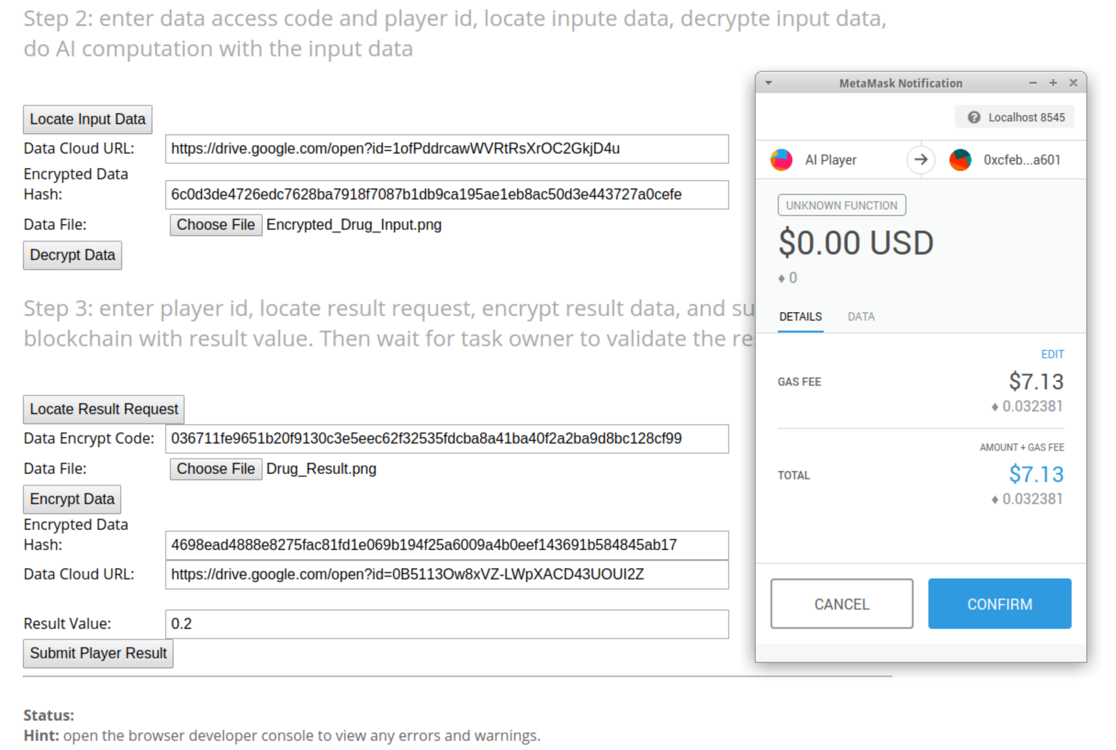
Task Management: Do AI Computation
Off-Chain Operation: Do AI computation with decrypted data input, and obtain a result file
Encrypt AI result with Task Owner’s Data Encrypt Code
Upload result and value to blockchain
7. Locate Data Encrypt Code (public key) from blockchain with your player ID, which is 0 in the example
8. Choose the result file, click “Encrypt Data” and get an encrypted file
10.
9. Upload the encrypted result to cloud, put the URL here, as well as the result value, then click “Submit Player Result”

Slide 24
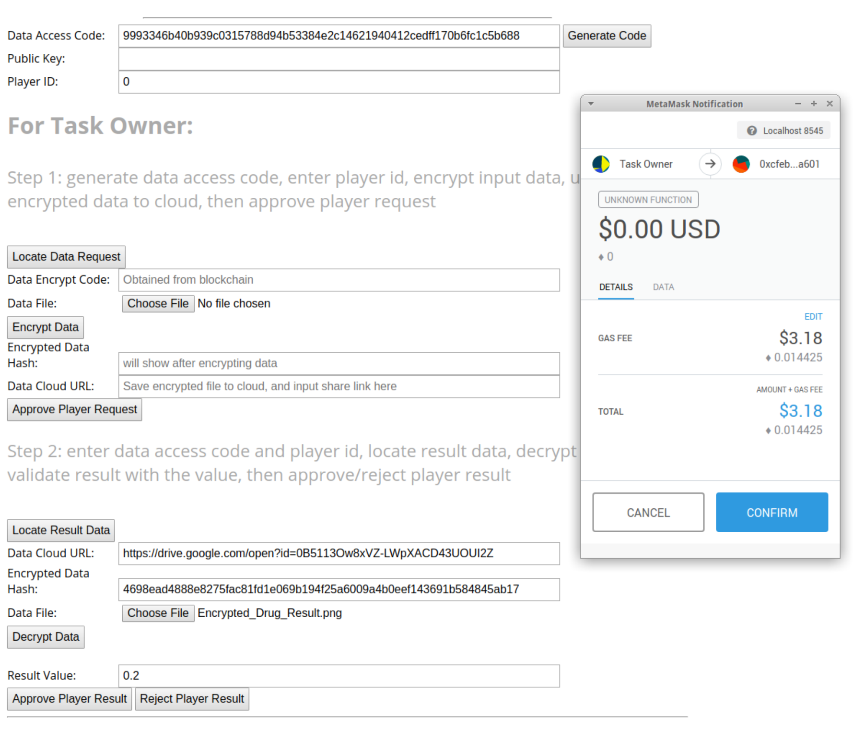
Task Management: Verify AI Result
1. Put the data access code generated in “Approve An AI Player” here
Please SWITCH to Task Owner for this operation
Decrypt result file with Data Access Code
Verify the result, and decide whether to approve or reject the result from AI Player
2. AI Player ID, of which you want to verify the AI result
3. Click “Locate Input Data” to retrieve URL and hash from blockchain, download the encrypted file
6.
4. Choose the encrypted file, click “Decrypt Data” to obtain the decrypted result.
5. Verify the result, decide whether to approve/reject the result from AI Player. Here we choose approve

Slide 25
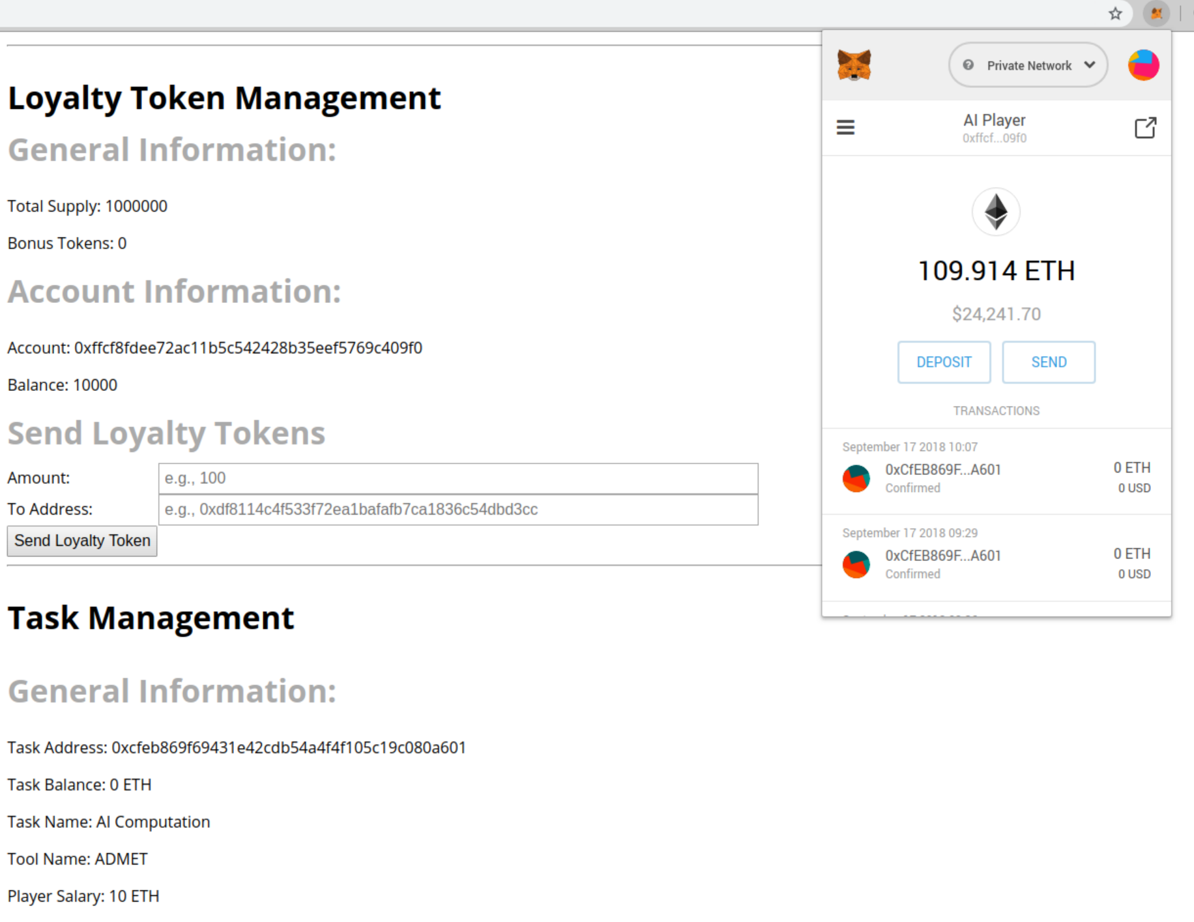
Task Management: Check Salary and Bonus
Please SWITCH to AI Player for this page
Since AI Player successfully finished the ADMET task, he received 10 ETH as salary, and 10,000 LT as bonus.
Contract bonus balance updated to 0 LT
Got salary from the task
ETH Balance increased
AI Player’s balance increased from 0 LT to 10,000 LT
Contract balance changed from 10 ETH to 0 ETH!

Slide 26
Additions for Scenario 2
Replace “app”, “contracts”, “migrations” folders with the ones in “app_scenario_2” folder, delete “build” folder
Compile and migrate the contracts to Ethereum network, restart the server：
Open a terminal in the current folder, do the following commands:
pkill ganache-cli # kill ganache-cli
pkill npm # kill npm run dev
ganache-cli -d & # run in a new tab
truffle compile
truffle migrate
npm run dev & #run in a new tab
Close and re-open web browser for “http://localhost:8080”

Slide 27
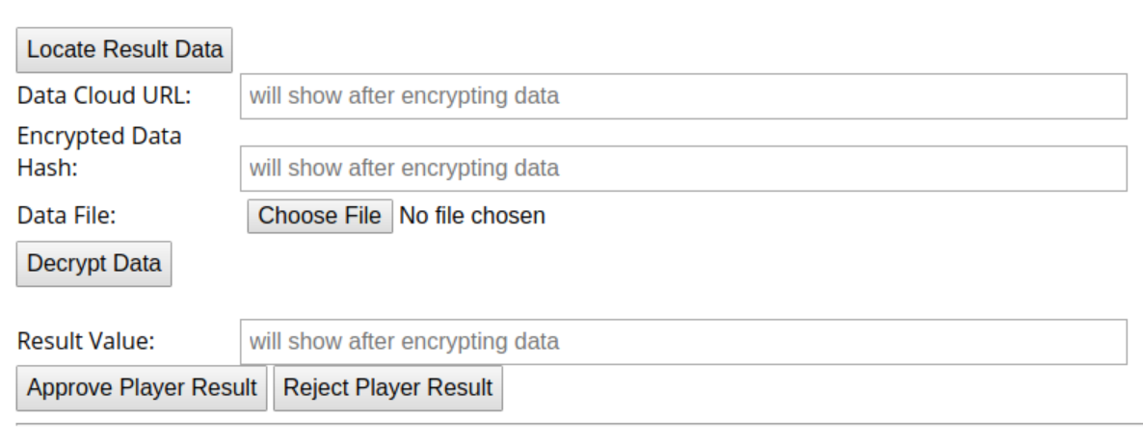
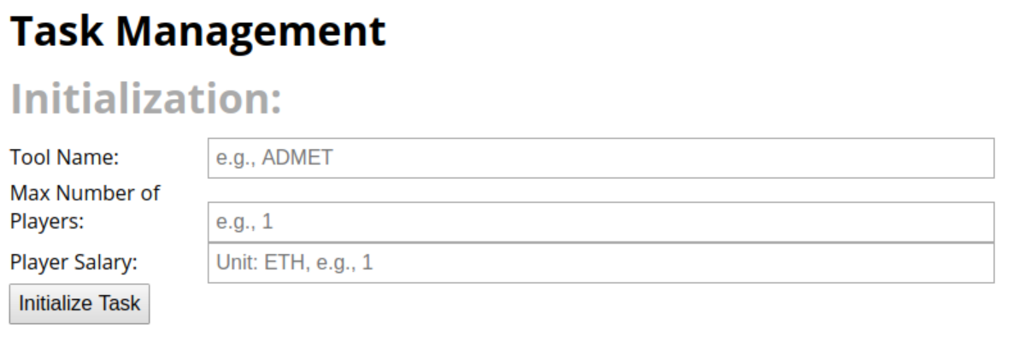
Additions for Scenario 2
Then you will see the following new options in Task Management:
Now the task has the capability to accept multiple AI players
When the result are approved, each AI Player will receive same salary from Task Owner, but only the AI Player wins in Cross Validation will be awarded the bonus loyalty token. In this example, winner must has the minimum result value and use least time.

Slide 28
Additions for Scenario 3
Replace “app”, “contracts”, “migrations” folders with the ones in “app_scenario_3” folder , delete “build” folder
Compile and migrate the contracts to Ethereum network, restart the server：
Open a terminal in the current folder, do the following commands:
pkill ganache-cli # kill ganache-cli
pkill npm # kill npm run dev
ganache-cli -d & # run in a new tab
truffle compile
truffle migrate
npm run dev & #run in a new tab
Close and re-open web browser for “http://localhost:8080”

Slide 29
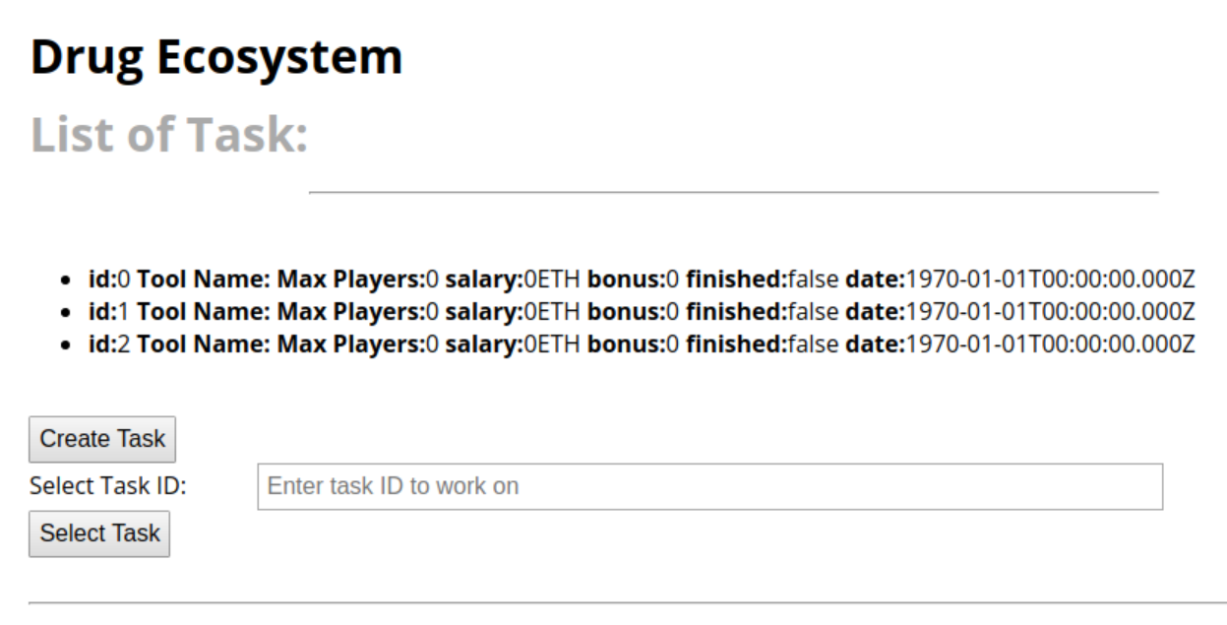
Additions for Scenario 3
Then you will see the following new Drug Ecosystem panel:
All drug tasks in the ecosystem will be list here
Everyone can create a drug task
Select a drug task by Task ID, then you will see the three components introduced in previous slides

Slide 30
Thank You!

